Slide 1

NOTICE BOARD
ITM UNIVERSITY,RAIPUR
VOCATIONAL TRAINING :-
PHP & MY SQL
PROJECT ON :-
SYSTEM
St. By :- SatyaJeet Chourasia

Slide 2
PHP
PHP is a server scripting language, and a powerful tool for making dynamic and interactive Web pages.
PHP is a widely-used, free, and efficient alternative to competitors such as Microsoft's ASP.
A PHP script can be placed anywhere in the document.
A PHP script starts with <?php and ends with ?>:

Slide 3
DECLARING A PHP
Example
<!DOCTYPE html> <html> <body> <?php echo "My first PHP script!"; ?> </body> </html>

Slide 4
DATA TYPES
Variables can store data of different types, and different data types can do different things.
PHP supports the following data types:
String
Integer
Float (floating point numbers - also called double)
Boolean
Array
Object
NULL
Resource

Slide 5
Creating (Declaring) PHP Variables
In PHP, a variable starts with the $ sign, followed by the name of the variable:
Example
<?php $txt = "Hello world!"; $x = 5; $y = 10.5; ?>

Slide 6
PHP Operators
Operators are used to perform operations on variables and values.
PHP divides the operators in the following groups:
Arithmetic operators
Assignment operators
Comparison operators
Increment/Decrement operators
Logical operators
String operators
Array operators

Slide 7
The PHP for Loop
The for loop is used when you know in advance how many times the script should run.
Example
<?php for ($x = 0; $x <= 10; $x++) { echo "The number is: $x <br>"; } ?>

Slide 8
PHP Function
PHP User Defined Functions
Besides the built-in PHP functions, we can create our own functions.
A function is a block of statements that can be used repeatedly in a program.
A function will not execute immediately when a page loads.
A function will be executed by a call to the function.
PHP Function Arguments
Information can be passed to functions through arguments. An argument is just like a variable.
Arguments are specified after the function name, inside the parentheses. You can add as many arguments as you want, just separate them with a comma.
The following example has a function with one argument ($fname). When the familyName() function is called, we also pass along a name (e.g. Jani), and the name is used inside the function, which outputs several different first names, but an equal last name:

Slide 9

PHP 5 Form Handling
PHP - A Simple HTML Form
The example below displays a simple HTML form with two input fields and a submit button
<!DOCTYPE HTML> <html> <body> <form action="welcome.php" method="post"> Name: <input type="text" name="name"><br> E-mail: <input type="text" name="email"><br> <input type="submit"> </form> </body> </html>
OUTPUT

Slide 10

PHP 5 Arrays
An array stores multiple values in one single variable:
Example
<?php $cars = array("Volvo", "BMW", "Toyota"); echo "I like " . $cars[0] . ", " . $cars[1] . " and " . $cars[2] . "."; ?>
OUTPUT

Slide 11
SQL
MySQL is a database system used on the web
MySQL is a database system that runs on a server
MySQL is ideal for both small and large applications
MySQL is very fast, reliable, and easy to use
MySQL uses standard SQL
MySQL compiles on a number of platforms
MySQL is free to download and use
MySQL is developed, distributed, and supported by Oracle Corporation
MySQL is named after co-founder Monty Widenius's daughter: My

Slide 12
Language used to developed Online Notice Board
Front end : HTML, CSS, Jquery, Bootstrap
Middle end : PHP
Back end : MySQLi

Slide 13
Open a Connection to MySQL
Before we can access data in the MySQL database, we need to be able to connect to the server:
Example (MySQLi Object-Oriented)
<?php $servername = "localhost"; $username = "username"; $password = "password"; // Create connection $conn = new mysqli($servername, $username, $password); // Check connection if ($conn->connect_error) { die("Connection failed: " . $conn->connect_error); } echo "Connected successfully"; ?>

Slide 14
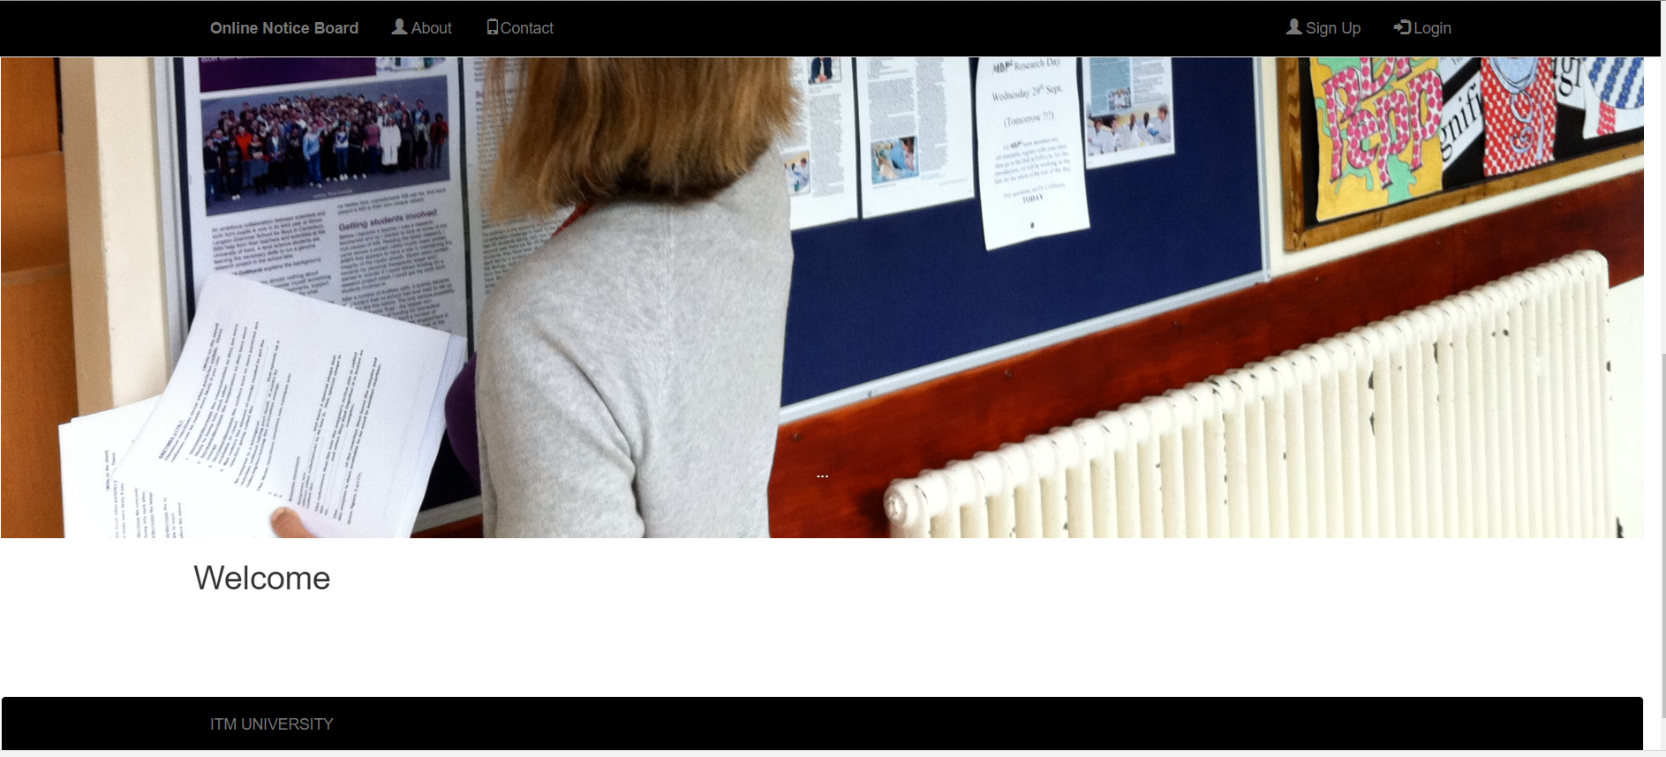
WELCOME

Slide 15
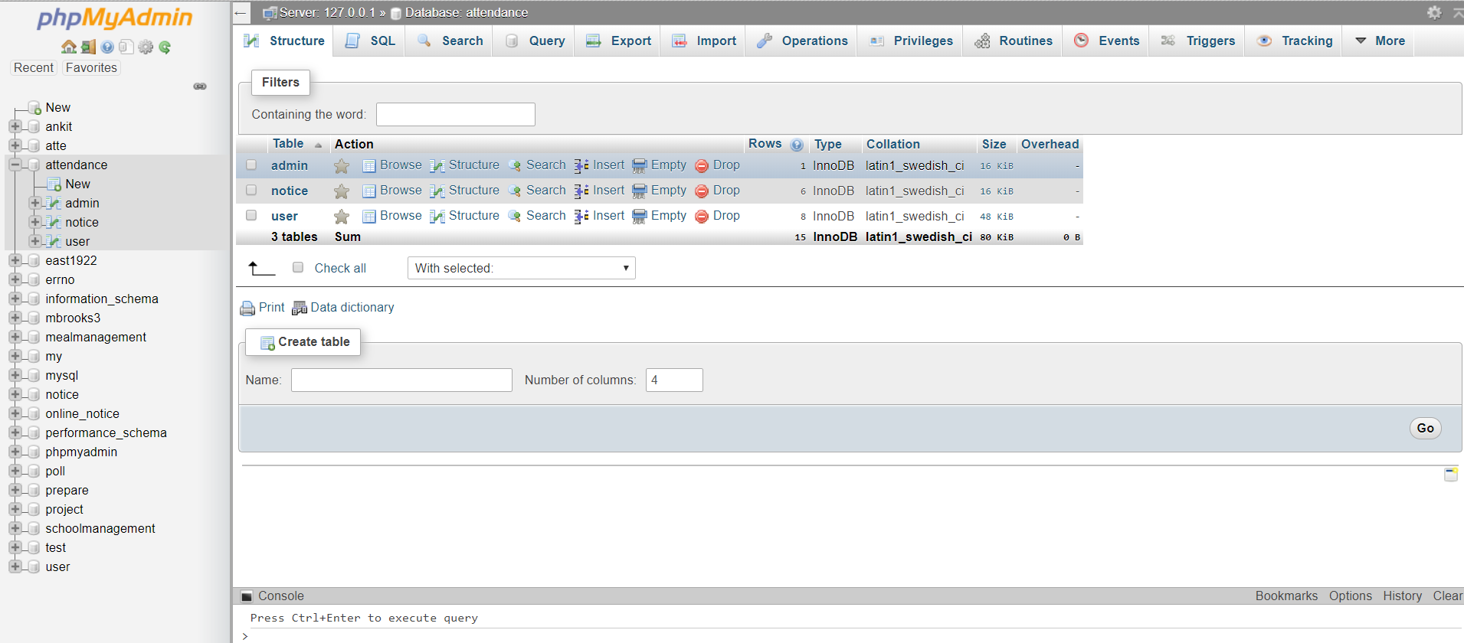

Slide 16
AIM
An online notice board is a place where people can leave any types of messages and notifications, for example, to advertise things, announce events or provide any information.
Notice board online it can be placed on digital devices such computers, tabs, mobile phones etc.
This online notice board project is very helpful for all type of users like existing users and new users. So admin can leave and erase notification for other people to read and see.
The main aim of this free online notice board project is make information dissemination much easier in a paperless community as the world tends to interact with the online notice board facility as an project, Online notice board admin can send the notification to the particular students regarding fee payments, results, any new activity happen in college campus or college fest participation, libraries dues, hostel room payments, any workshop registrations, warnings and reminders etc for this work online notice board project is make all work much easier and understandable to all.
This online notice board work generally intends to act as a support system for the all users.

Slide 17
By the help of free online notice board users can access the notifications and articles quickly not only in the particular premises, also wherever and whenever they need to know.
Online notice board usability is fully capable of passing relevant notices and announcements, and keeping the users update from time to time.
The students are kept updated each time with the online notice board for college is uploaded based on their preferences with respect to the departments and categories through a notice board online.
L Line notice board is one of the applications to improve the usage of notice board of the college by making it available online.
This web application involves almost all the features of online notice board.
In the online notice board project all the updates like, add, delete, view are done by admin, so that user will get the updated current information through notice board online .

Slide 18
Admin
Admin is the person who controls, monitors and keeps the whole follow of the system. The main functions of the Admin are:
To keep and track down the total number of users in the system.
Can add, activate and deactivate any user.
Add New Notice and send notice to Registered users
Display Old Notice and Manage Old notice
Update Password

Slide 19
Student
Student is a knowledge seeker, or more theoretical word, a learner. The student has to be registered and log in into the system before he/she carries out their functions.
Student Registration
Login
Check Notification sent by admin
Update Profile
Update Password
Log out the whole system

Slide 20
THANKYOU

